Slide 1


Improving Out-of-Distribution Generalization by Adversarial Traing with Structured Priors
Qixun Wang¹, Yifei Wang¹, Hong Zhu², Yisen Wang¹
¹Peking University ²Huawei Noah’s Ark Lab
Neural Information Processing Systems (NeurlPS 2022)

Slide 2
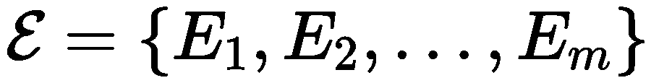

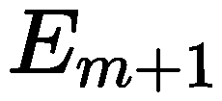
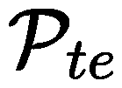
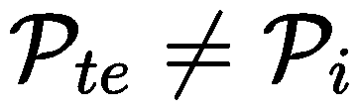
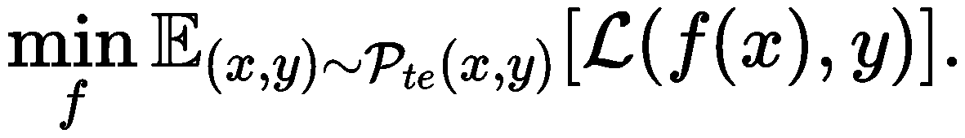
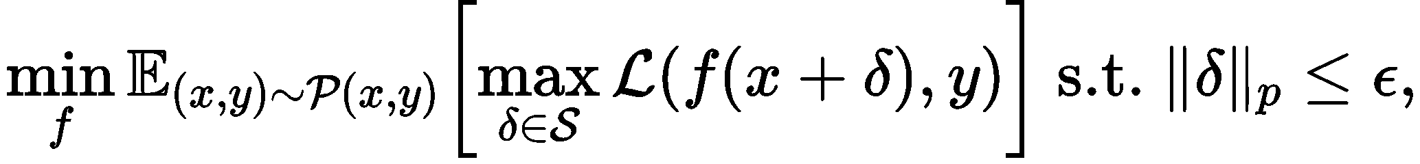
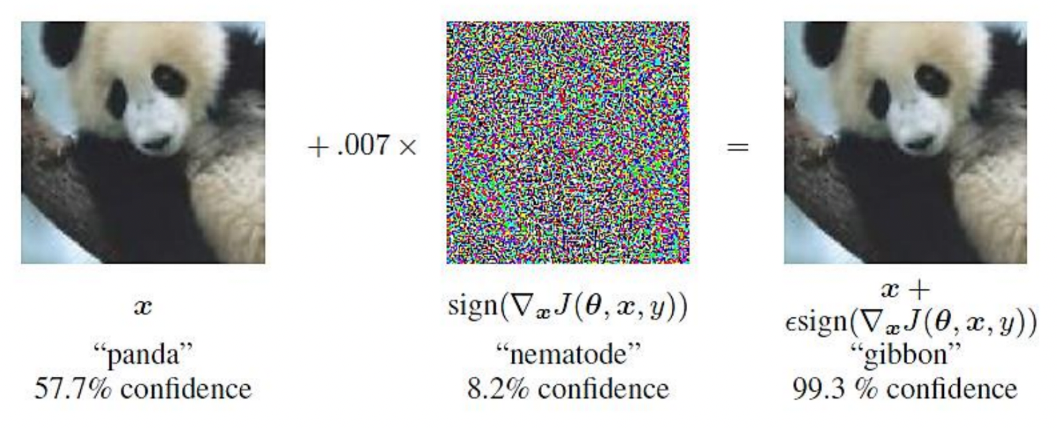
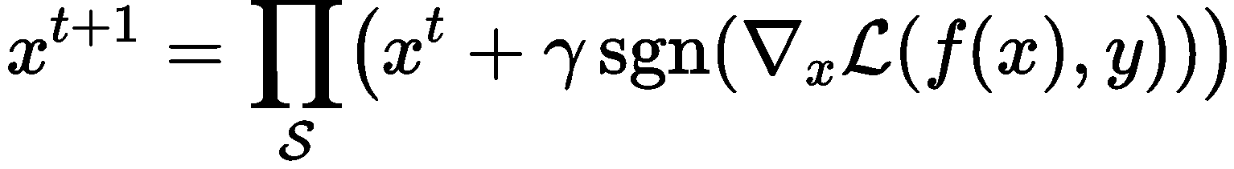
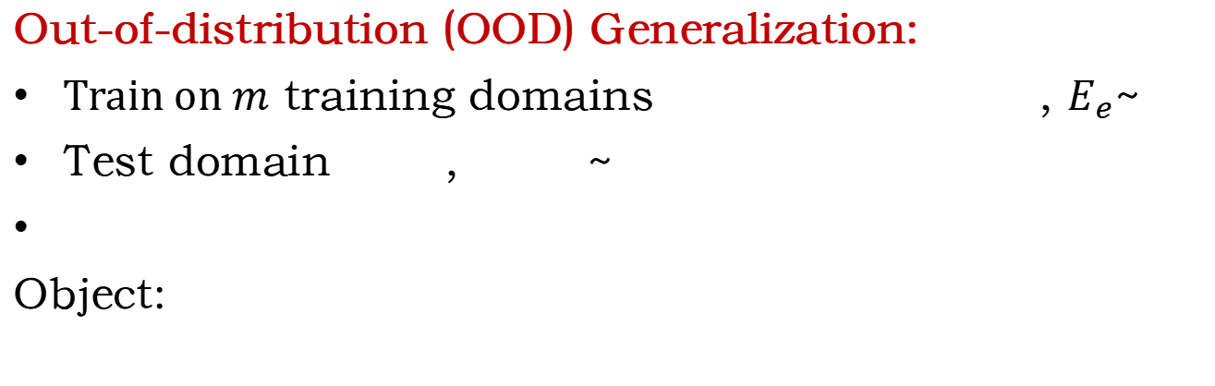
Out-of-distribution (OOD) Generalization:
Train on $m$ training domains , $E_{e}$~
Test domain , ~
Object:
Solve
Adversarial Training (AT):
Optimization problem:
Inner maximization can be solved by:
FGSM
or PGD
Adversarial Attack
Ian Goodfellow et al., 2014
originally for defending

Slide 3
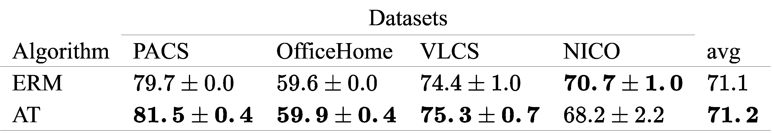
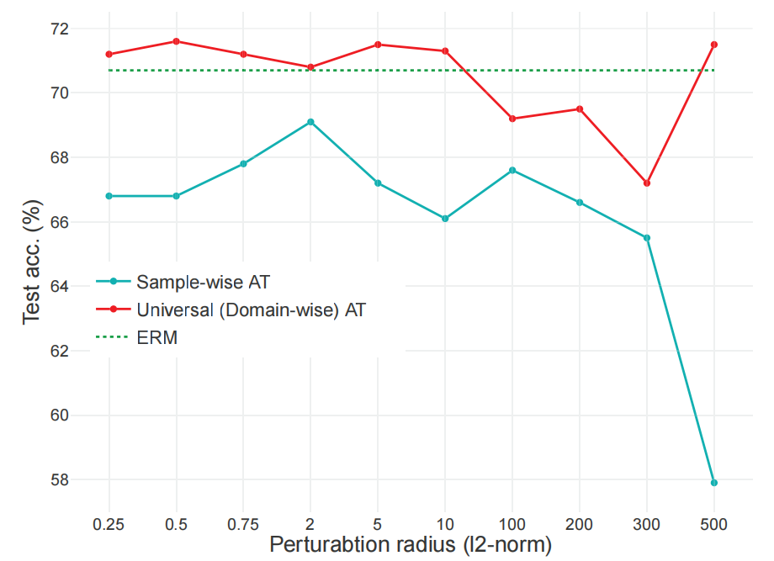


Previous work of using AT to address OOD
[Yi et al, 2021][Volpi et al, 2018]:
1. Use Wasserstein distance, less practical
2. No further investigation on the effect of different forms of AT
[Herrmann et al, 2021]
Do not exploit the universal spurious information (background/style)
Limited,
not effective enough
verify the weaknesses
Our Methods:
MAT & LDAT
Our findings
The improvement of sample-wise AT is marginal.
motivate
UAT (Universal AT) remains its generalization performance when the perturbation scale is large.
Samll perturbations
Large perturbations
Low-rank, domain-wise structures are beneficial for OOD!
conclude
less like OOD shifts
more like OOD shifts

Slide 4
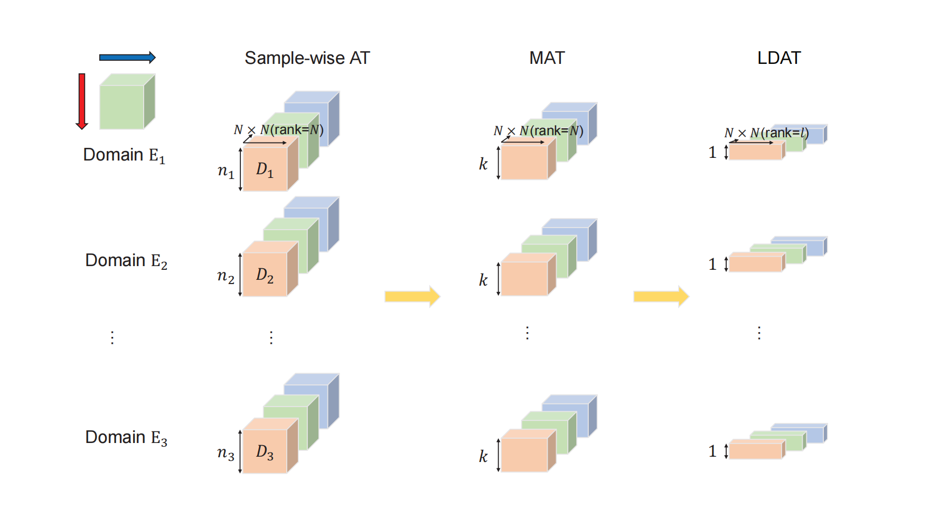
The Proposed Structured AT Method
Reduce the rank of the adversarial perturbations along two orientations:
Reduce number of the perturbations used in a domain
Reduce the rank of a single perturbation matrix
what MAT & LDAT do
what LDAT does
Low-rank, domain-wise structures are beneficial for OOD!
motivate
Our Methods:
MAT & LDAT

Slide 5
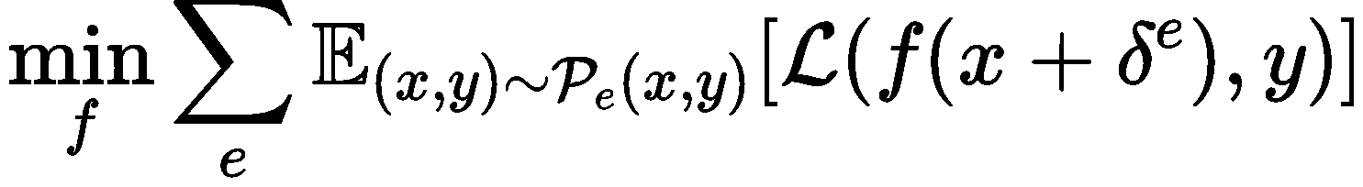
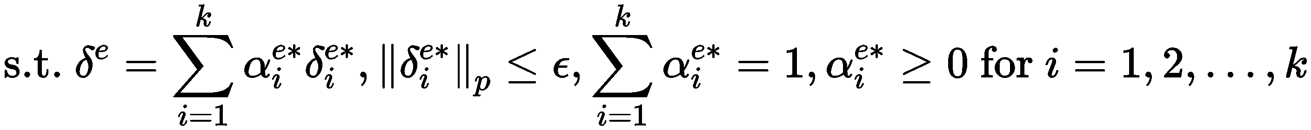
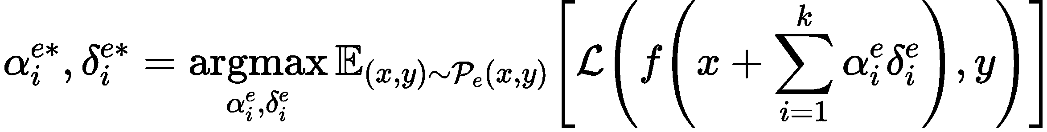
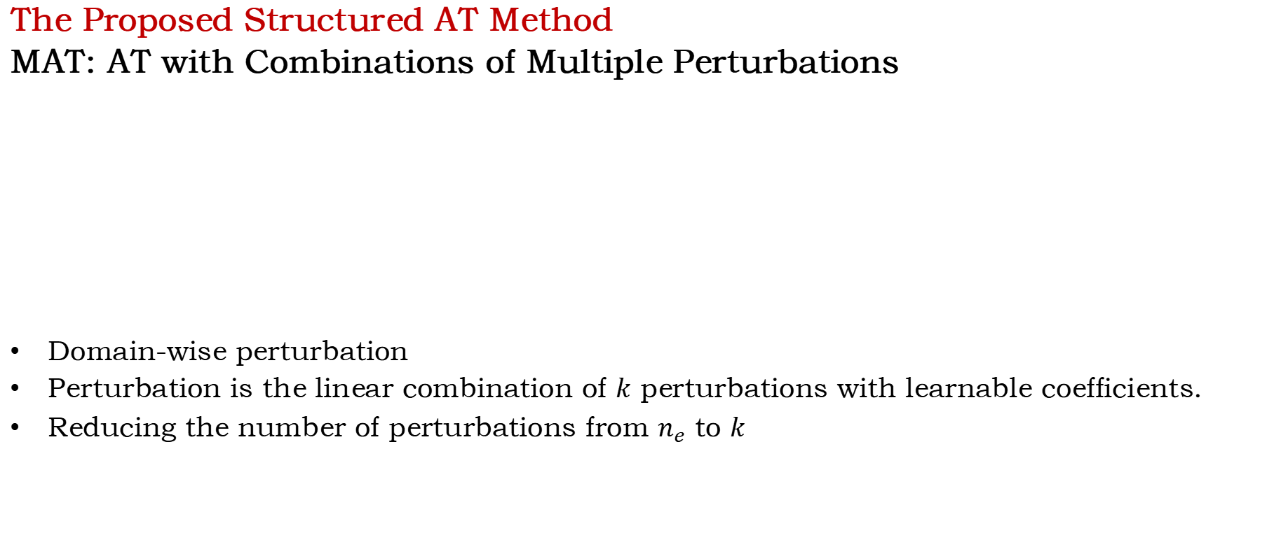
The Proposed Structured AT Method
MAT: AT with Combinations of Multiple Perturbations
Domain-wise perturbation
Perturbation is the linear combination of $k$ perturbations with learnable coefficients.
Reducing the number of perturbations from $n_{e}$ to $k$
Reduce the number of the perturbations used in a domain
Maintain some diverse structures to model more complex background

Slide 6
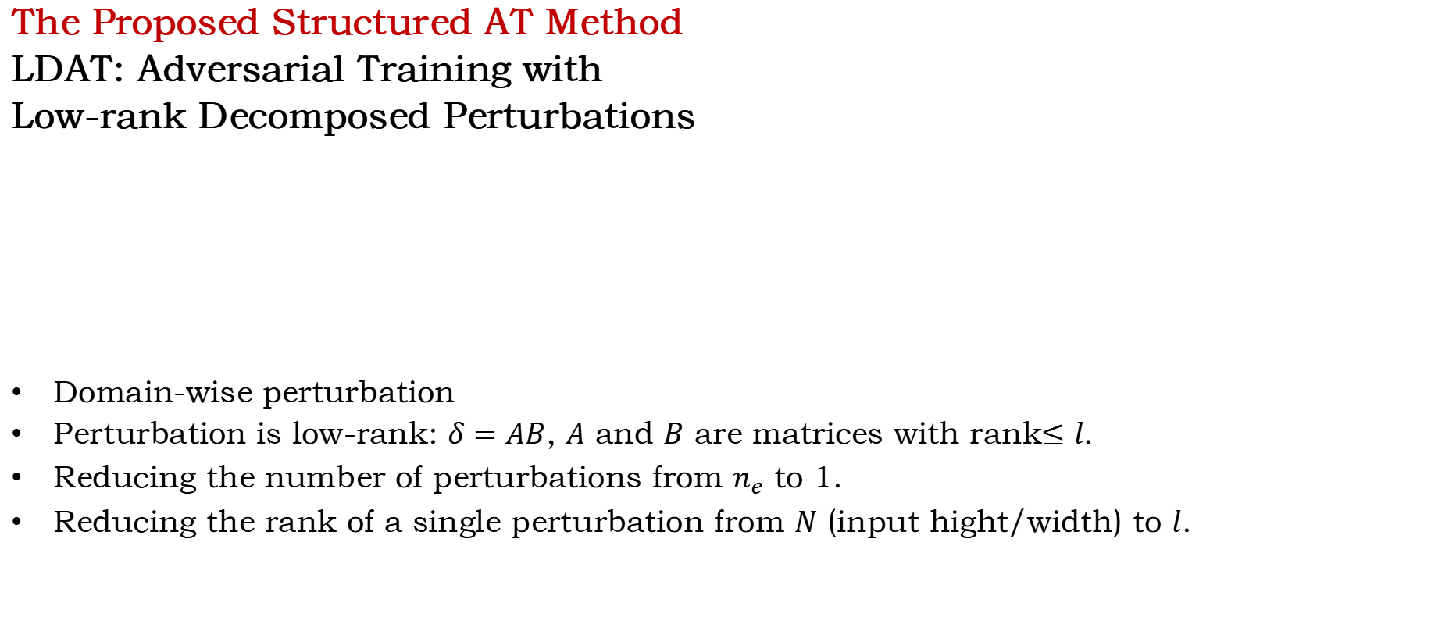
The Proposed Structured AT Method
LDAT: Adversarial Training with
Low-rank Decomposed Perturbations
Domain-wise perturbation
Perturbation is low-rank: $δ=AB$, $A$ and $B$ are matrices with rank$≤l$.
Reducing the number of perturbations from $n_{e}$ to 1.
Reducing the rank of a single perturbation from $N$ (input hight/width) to $l$.
Reduce the number of the perturbations used in a domain
Further reduce the rank of a single perturbation matrix

Slide 7
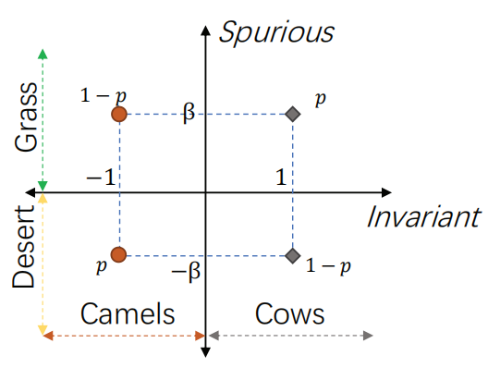
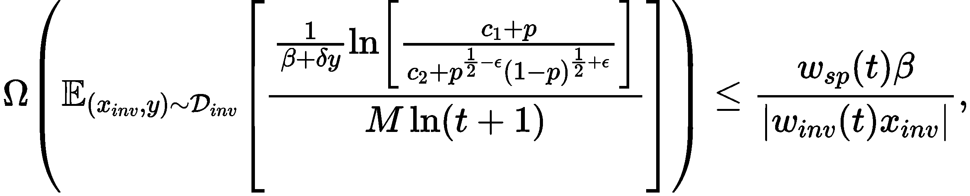
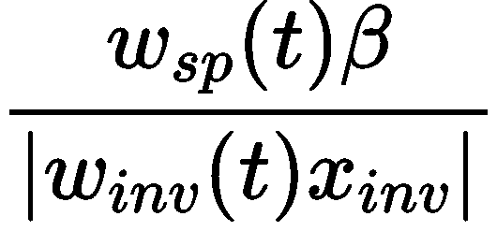
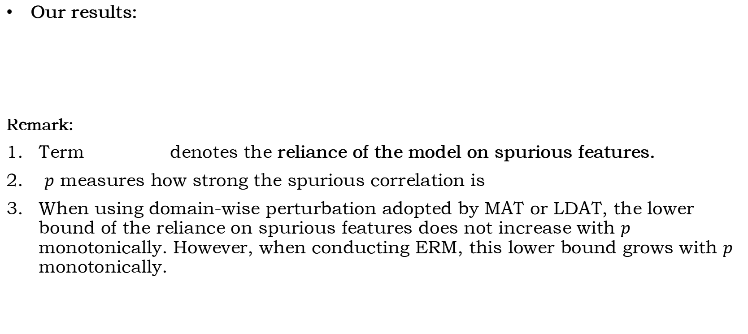
Theoretical Analysis
Our results:
Remark:
Term denotes the reliance of the model on spurious features.
$p$ measures how strong the spurious correlation is
When using domain-wise perturbation adopted by MAT or LDAT, the lower bound of the reliance on spurious features does not increase with $p$ monotonically. However, when conducting ERM, this lower bound grows with $p$ monotonically.
MAT/LDAT is better than ERM on OOD data!

Slide 8
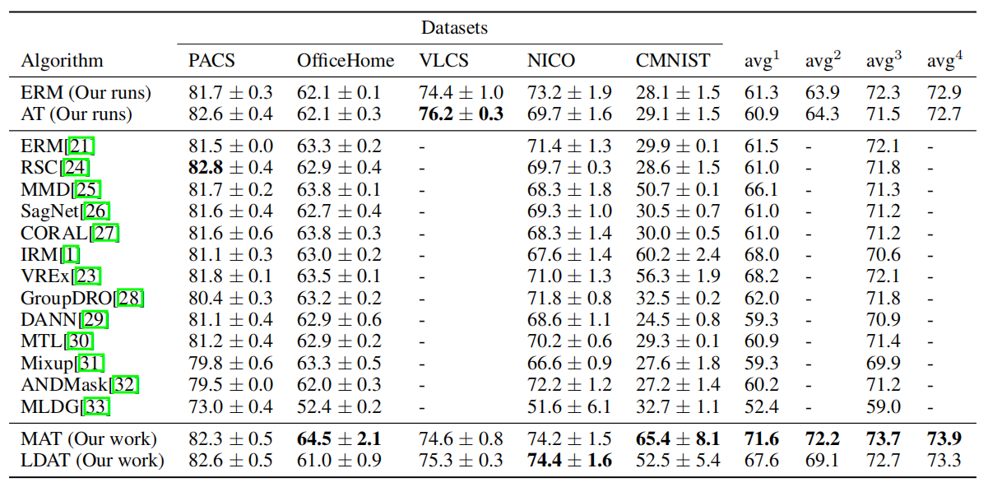

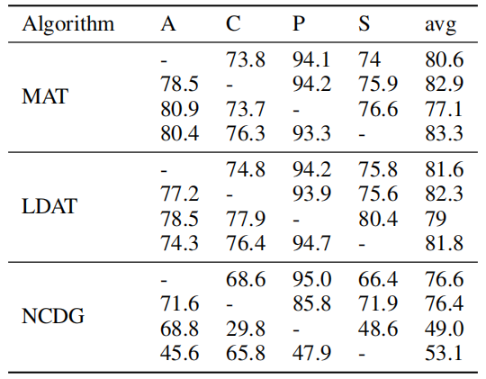
Experiments
MAT and LDAT beat GUT (Volpi et al, 2018) and NCDG (Tian et al, 2022), two data augmentation methods for OOD
On Domainbed, an OOD generalization benchmark
MAT and LDAT outperform ERM and AT, ranked 1st and 4th among all algorithms.

Slide 9
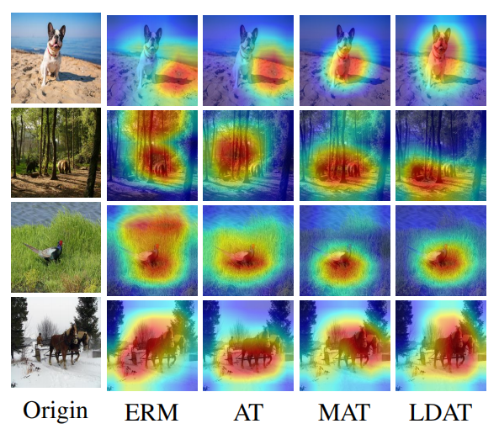
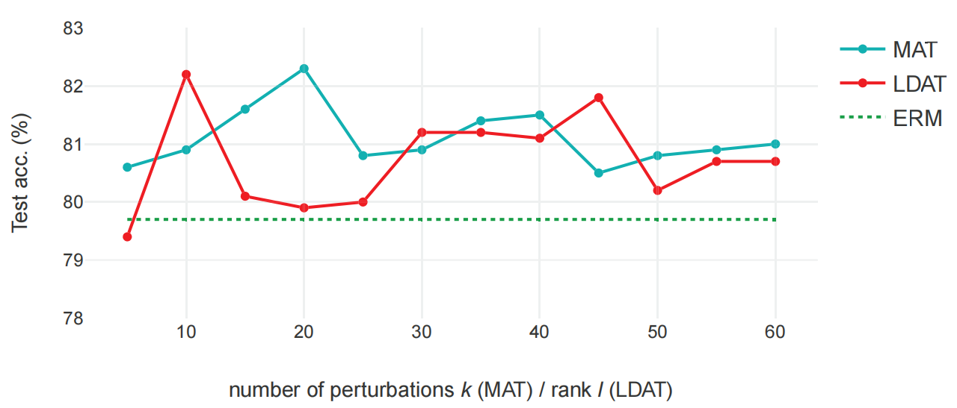
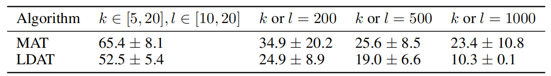
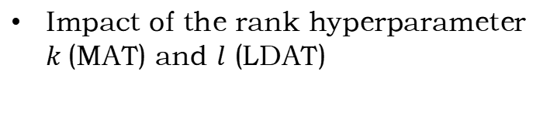
Experiments
Impact of the rank hyperparameter $k$(MAT) and $l$ (LDAT)
Visualization (GradCam)
on PACS
on CMNIST
MAT and LDAT better focus on the object rather than background.
Insights:
rank is samll enough: good performance
rank is too samll or too big: bad performance

Slide 10
Thanks!

